Slide 1
The Magenta Principles

Slide 2
Cad é atá i gceist?
Athraithe beaga a dhéanann difir i bhfoghlaim na ndaltaí.
Foghlaim Gníomhach.
Na dóigheanna is fearr a dtig le daltaí eolas a láimhseáil, a úsáid agus a thuigbheáil.

Slide 4
Athshuimigh Ordaigh Déan Rangú
Eagraigh Leadaigh Déan compáraid Cuir le
Athraigh Ceangail Cóimeáil

Slide 5
Athshúimigh/Replace
Míniú:
Athraigh an t-eolas ach coinnigh an ciall.
Samplaí Eile:
Foclóireacht
Poncaíocht
Ceistiú Éifeachtach
Taboo
@RoinnNaGaeilge
@CCEA

Slide 6
Ordaigh/Sequence
Míniú:
Ag cuir eolas in ord agus ag míniú cad chuige.
Samplaí Eile:
Diamond 9
Shraithphictiúir
Sreabhchairt
@RoinnStaire

Slide 7
Rangú/Classify
Míniú:
Ag rangú eolais de réir a gcritéir féin.
Samplaí Eile:
Obair iomlán neamhspléach (Facilitator Vs Instructor)
@RoinnTíreolaíochta

Slide 8
Eagraigh/Arrange
Míniú:
Ag eagrú eolais de réir critéir le tuiscint a thaispeáint.
Samplaí Eile:
Leáráid Venn
Graif
Táblaí
‘Mind Maps’
@RoinnEacnamíocht Baile

Slide 9
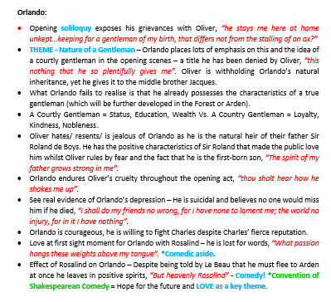
Leadaigh/Reduce
Míniú:
Ag laghdú eolais ar mhaithe leis na rudaí is tábhachtaí a aithint.
Samplaí Eile:
Twitter (Seisiún Iomlánach)
Pictiúir
Graif
Uirlis Stáidéir
@RoinnAnBhéarla

Slide 10
Cur i gcomparáid/Compare
Míniú:
Roghnaigh an ceist is deacra/fusa chun díospóireacht a thoiseacht leis an rang.
Samplaí Eile:
Leáráid Venn
Graif
Díospóireacht
@RoinnAnMatamaitice

Slide 11
Cuir le/Add
Míniú:
Daltaí ag tabhairt níos mó eolais ná mar atá os a gcomhair.
Samplaí Eile:
Scileanna Infeireas
Suíochán Te
Dialann
Radharcanna/ Paragraif
@RoinnDrámaíochta

Slide 12
Athraigh/Change
Míniú:
Athraigh an t-eolas le do chuid tuiscint a léiriú.
Character | Meal | Chef
Curley’s Wife | Raspberry and white chocolate roulade, with strawberries and cream | Rossa
Curley | Curly fries | Amy
Lennie | Burger chips and chocolate milkshake | Aisling
George | Steak and chips | Robyn
Crooks
Slim
Carlson | Chicken pie | Darragh
The Boss
Aunt Clara
Candy | Chocolate fudge cake with whip cream | Críostóir
Evidence (Justify your choices - USE PEEEZ).
I think that if George were a dish he would be steak and chips. I chose this dish for George because the author portrays George as a traditional man's man we see this when he describes George as “ Small and quick, dark of face, with restless eyes and sharp, strong features” . This is why I chose a savoury meal instead of a sweet dessert. George is also described as being manly when... Robyn
I think that if Lennie were a dish he would be burger chips and a chocolate milkshake I choose this dish because Lennie is describes to the reader as childish. For example ‘in panic Lennie looked at George for help'. This is why I chose a kids meal instead of an adults meal. Lennie is also describes childish when he says Lennie says breathlessly, "he's brown an’ white jus’ “I didn't mean no harm George honest I didn't I jus’ wanted to pet um a little” this shows that Lennie is like a child and doesn't understand the harm he was causing that might be danger later on in the book. Aisling
If Curley were a dish I'd have to say he’d be curly fries .My reasons of picking this dish is because he is described as “A thin young man with a head of tightly curled hair” in my opinion they way he was described just remedies you of curly fries in how thin and curly they are it .Of course he’s name is a reason too it also reminds you of curly fries. As well as he is described as very small which is also how curly fries look. We've also read about how rough he is and how he likes to pick fights with tall people this shows how much of a small angry man he is. This is my reason for picking this dish. Amy
Samplaí Eile:
Téacs > Léaráid
Eochairfhocail> Dán
Dán > Léaráid Líne
Ealaín > Ceol
@RoinnAnBhéarla

Slide 13
Ceangail/Connect
Míniú:
Ag aithint nascanna ábhartha.
Samplaí Eile:
Snap
Dominoes
Odd one out
@RoinnNaFraincise

Slide 14
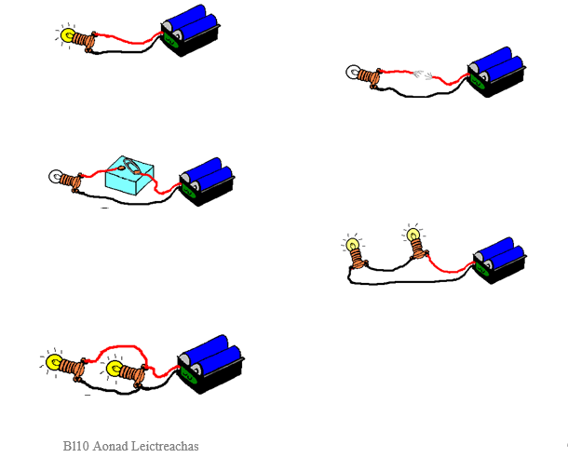
Cóimeáil/Assemble
Míniú:
Ag tabhairt tasc do na daltaí ag tógáil ar an réamh fhoghlaim.
Samplaí Eile:
‘Snowballing > Think, Pair, Share’
‘Speed Dating’
‘Jigsaw’
@RoinnNahEolaíochta

Slide 15
Bain triail as!
Caithfidh Magenta a bheidh bainte le do critéir reatha agus spriocanna foghlama i gcónaí!

